Slide 1
Emotion analysis through facial recognition:
This project revolves around the immense potential of using facial recognition to detect various emotions portrayed by various people for continued durations of time so as to deduce integral data for further analysis

Slide 2
Business model
The business model designed for the project revolves around 9 primary sectors:
Value proposition
Key resources
Key activities
Key partnerships
Customer relations
Channels
Customer segments
Revenue streams
Cost structure

Slide 3
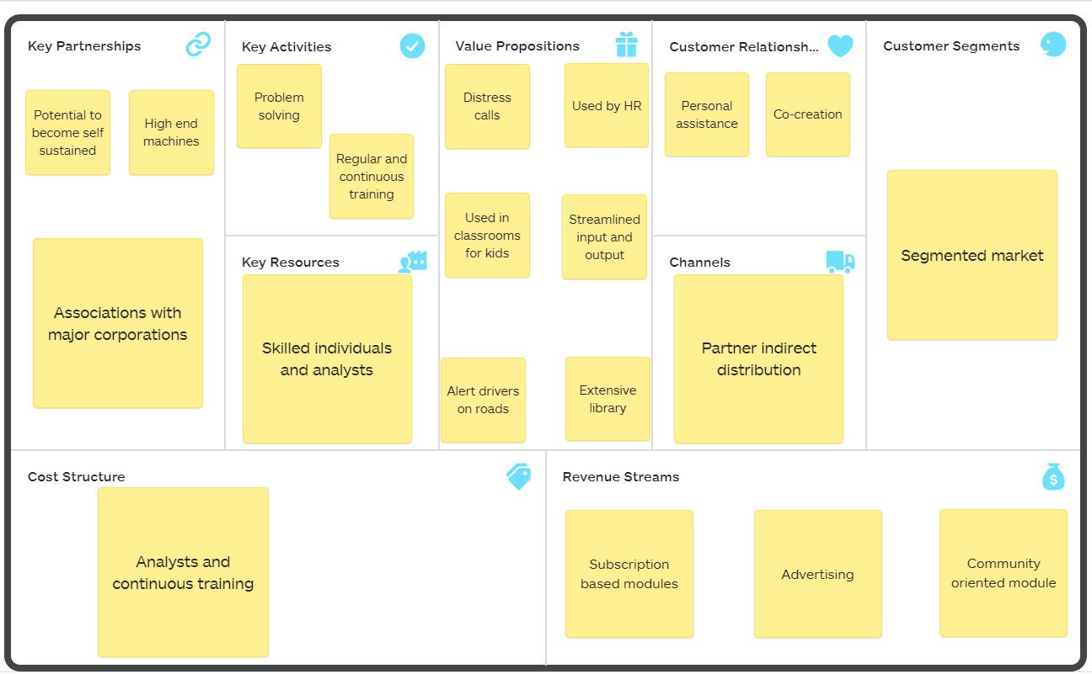

Slide 4
Value proposition
Distress call generation
Generate distress calls on the basis of the emotions recognized which can help the person in-case of danger.
Alert drivers on roads
In cases of extensive driving, it can be used to alert the driver so as to make sure the monotony does not get to him/her.
A basic message such as, "take a coffee break" or "adjust temperature" can work

Slide 5
Key resources:
1)The primary resources required for the upkeep and constant progress of the product is a skilled workforce composed of skilled individuals and analysts.
2) Business analysts to aid in the process of understanding the nuances and plausible repercussions of unforeseen outcomes.
3) Content strategist to design content for the product to ensure that enough awareness about the uses of the product is outspread.

Slide 6
Key activities:
Problem solving, where we:
design ingenious algorithms so as to ensure that the flagship and the benchmark of the product is maintained.
2) Regular and continuous training, where we:
Rigorous and continuous training of the model to make sure that even discernibly noticeable features are recognized and finer patterns are found

Slide 7
Key partnerships
Associations with major corporations:
Based on the mode of deployment of the model, the avenues to which the product can cater needs, is endless.
Naming a few:
1) Commercial vehicle producers
2) Security component developers
3) Medical institutions
4) Working sector of majority of companies

Slide 8
Customer relations:
1) Personal assistance:
Essentially, as a lot of the required components here are technical, a personal call attendance based service will be applied which will in-turn help out the customers with queries
2) Co-creation:
Owners of the product will be open to access an extensive FAQ page which is ever evolving by taking inputs from the customers as well where they answer queries posted by fellow members

Slide 9
Channels
Partner indirect distribution:
Essentially as the product works best when used in parallel and in cohesion with other essential products, it is imperative to note that the method of distribution would be on a retail basis so as to lower margins and maximize reach.

Slide 10
Customer segments
The market here would be a segmented market
->The target of the product is essentially a segmented market where the service provided is more or less the same but the application and the method of application might vary depending upon the need of the recipient company.

Slide 11
Revenue streams
Subscription based modules:
The primary source of revenue generation for a model deployed in a home for example can be the fact that the emotion packages deployed can consist of a few or more packages depending on the subscription they avail
Advertising:
Essentially, advertising the success of the model and displaying why it is the need of the hour would act as a major boost to gather funds and also create awareness about the product

Slide 12
Cost structure
Analysts and continuous training:
The primary cost structure would be dependent upon the resources required to hire the individuals required.
The secondary resource allocation would be on the intensive training of the model that would be performed regularly, over time so as to ensure that the customers get the best of experiences with the product and face no hassle.
The machines required to train and develop the models to be deployed too contribute to the cost structure

Slide 13
The project was made and presented by:
Name - Siddharth Singh
Name of university - SRMIST

